Slide 1

JAVA Abstraction and Interface
Object Oriented Programming

Slide 2

What is Abstraction?
It is an OOP techniques that hides certain details and only shows important information.
Abstraction in 2 ways:
Abstract Classes
Interfaces

Slide 3
The Abstraction
Abstract Class
Cannot be Instantiated to access it, you need to inherit it from another class
Abstract Methods
Can only declared inside an abstract class
It is a method without a body
It needs to be overridden in the subclass of the abstract class

Slide 4
Key Features of Abstraction
Simplification: Focuses on what an object does, not how it does it.
Security: Hides internal details from the user to protect data and reduce complexity.

Slide 5
Ways to Achieve Abstraction in Java
Abstract Classes: A class that cannot be instantiated and is meant to be inherited by other classes.
Interfaces: A reference type in Java that can contain only constants, method signatures, default methods, static methods, and nested types.

Slide 6

Abstract Classes Declaration
abstract class Vehicle
{
abstract void start();
abstract void stop();
}

Slide 7
Abstract Methods
A method that is declared without an implementation (no body).
Syntax:
abstract void start();

Slide 8
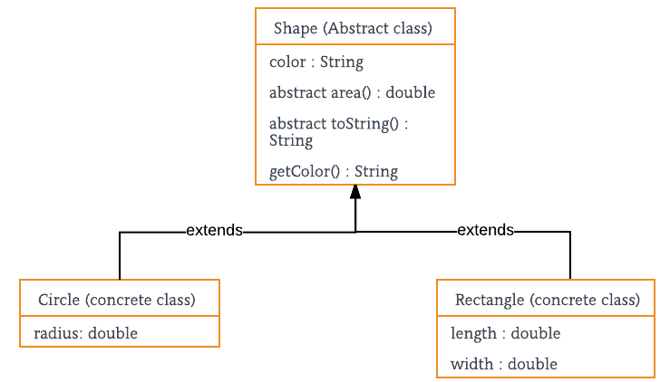
Example of Abstract

Slide 9

What is Interface in JAVA?
An interface in Java is a blueprint of a class. It has static constants and abstract methods.
The interface in Java is a mechanism to achieve abstraction. There can be only abstract methods in the Java interface, not method body. It is used to achieve abstraction and multiple inheritance in Java.

Slide 10
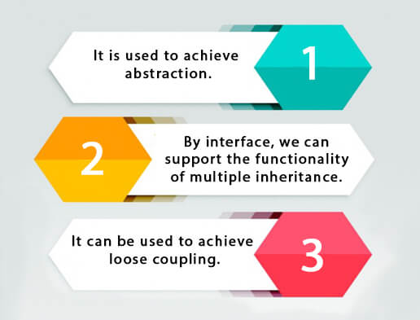
Why do we use an Interface?

Slide 11

Characteristics of an Interface
No Instantiation: An interface cannot be instantiated directly. A class must implement the interface to use it.
All Methods Are Abstract by Default (Java 7): In older versions of Java (Java 7 and below), all methods declared in an interface are implicitly abstract and public. From Java 8 onwards, interfaces can have concrete methods (default and static methods).
Fields Are Constants: All fields declared in an interface are implicitly public, static, and final, meaning they are constants.

Slide 12
Benefits of Interfaces
Abstraction: Interfaces allow you to define what an object can do without specifying how it does it.
01
Multiple Inheritance: They allow for the use of multiple inheritance in a way that classes cannot.
02
Flexibility: Since a class can implement multiple interfaces, interfaces provide more flexibility in designing systems.
03
Loose Coupling: Interfaces promote loose coupling by separating implementation from the specification.
04
Notes:
Loose Coupling and Interfaces in Java
Definition of Loose Coupling
Loose coupling refers to a design principle where different parts of a system (e.g., classes, modules) are minimally dependent on each other. This means that one part of the system can be changed without heavily impacting other parts.
The opposite of loose coupling is tight coupling, where components are highly dependent on each other, making changes more difficult and error-prone.

Slide 13
Difference Between Class and Interface
No. | Class | Interface
1. | In class, you can instantiate variables and create an object. | In an interface, you can’t instantiate variables and create an object.
2. | Class can contain concrete(with implementation) methods | The interface cannot contain concrete(with implementation) methods
3. | The access specifiers used with classes are private, protected, and public. | In Interface only one specifier is used- Public.

Slide 14
Differences between Abstract Class and Interface
Aspect | Abstract Class | Interface
Inheritance | Can extend only one abstract class. | Can implement multiple interfaces.
Methods | Can have both abstract and concrete methods. | Can have only abstract methods (Java 7 and below). Can have default and static methods (Java 8+).
Fields | Can have instance variables. | Only static and final variables.
Access Modifiers | Can have various access modifiers. | Methods are implicitly public.

Slide 15

Syntax of Abstract
abstract class
{
abstract function();
}

Slide 16
Syntax of Interface
interface {
// declare constant fields
// declare methods that abstract
// by default.
}

